Slide 1

Data Literacy

Slide 2
Definition
“Data literacy is the ability to read, understand, create, and communicate data as information. Much like literacy as a general concept, data literacy focuses on the competencies involved in working with data.”
https://en.wikipedia.org/wiki/Data_literacy

Slide 3
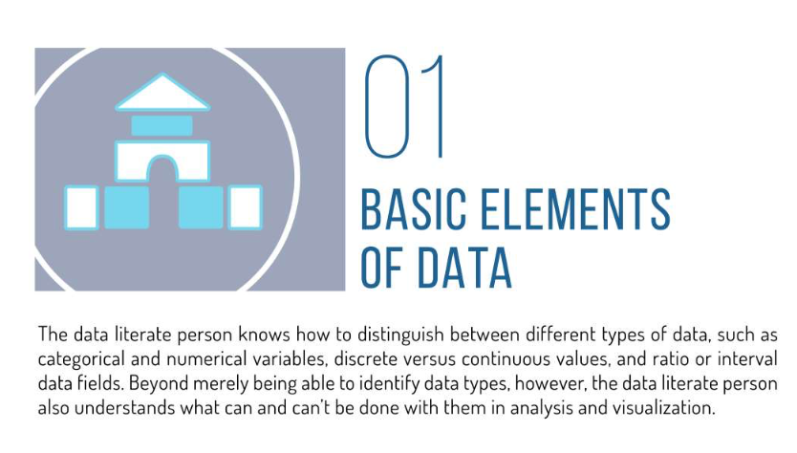
https://www.slideshare.net/dataremixed/17-key-traits-of-data-literacy

Slide 5
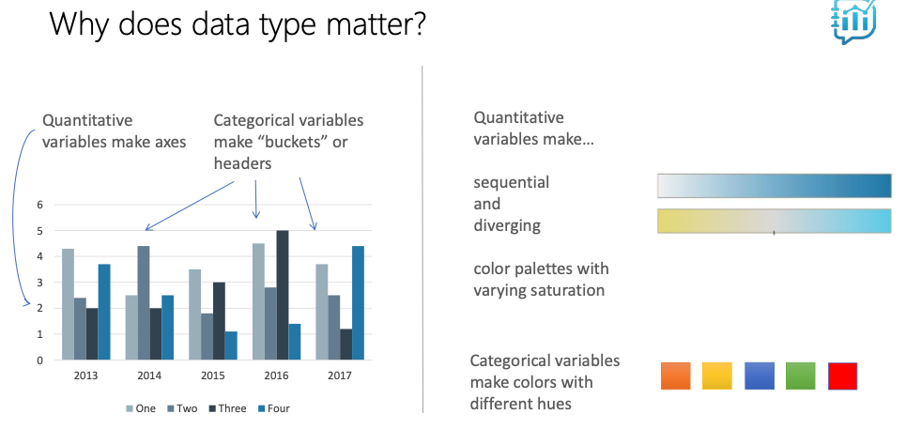

Slide 6
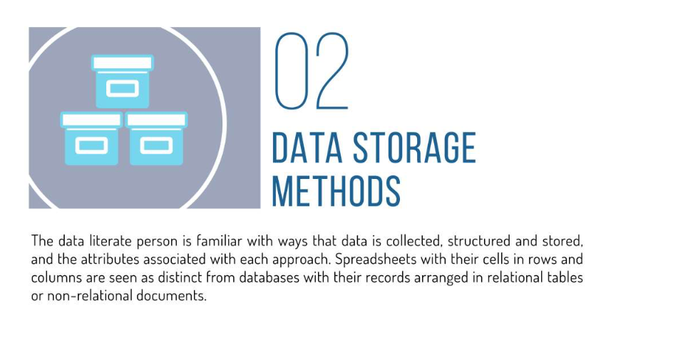

Slide 7
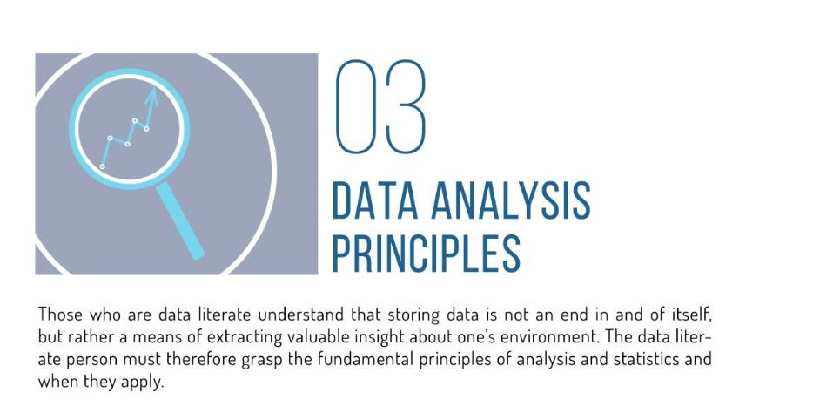

Slide 8
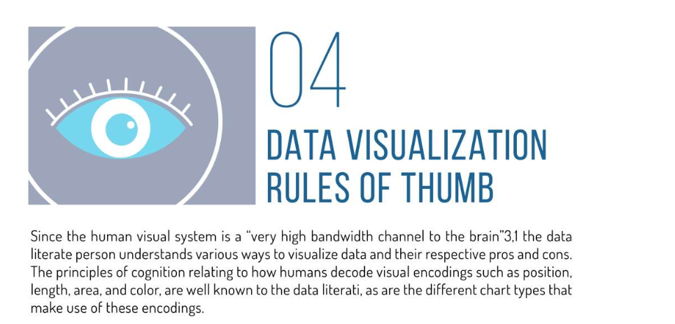
,
,
http://www.cs.ubc.ca/labs/imager/tr/2009/VisChapter/akp-vischapter.pdf

Slide 9
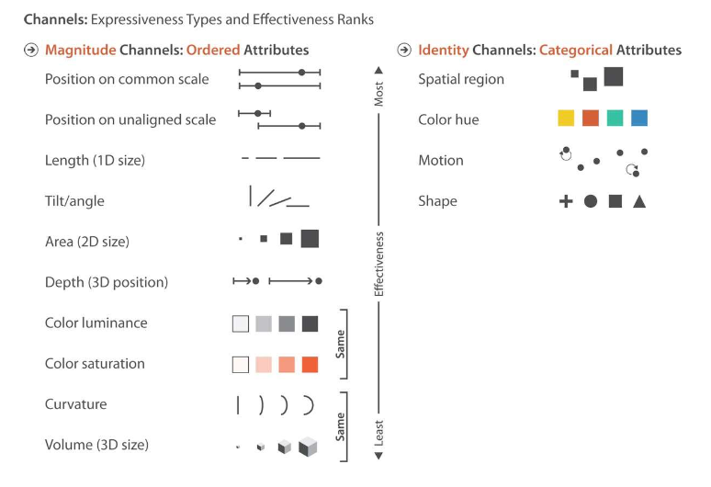

Slide 10
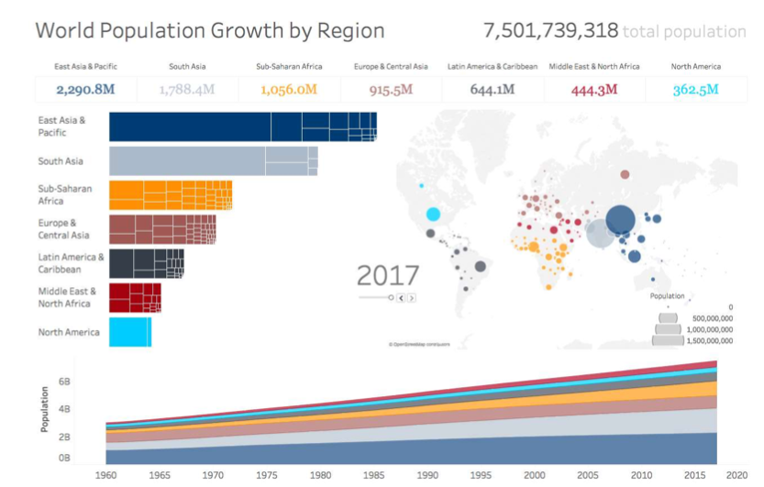
https://data.worldbank.org/indicator/SP.POP.TOTL

Slide 11
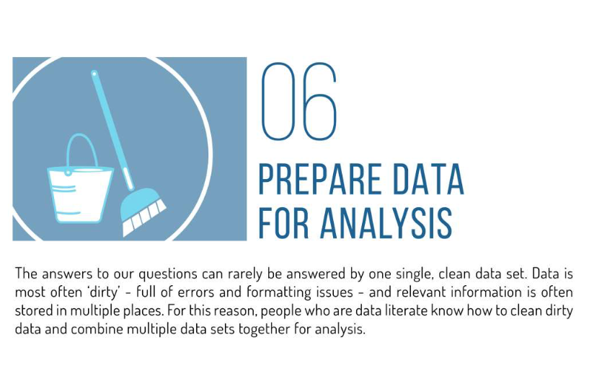

Slide 12
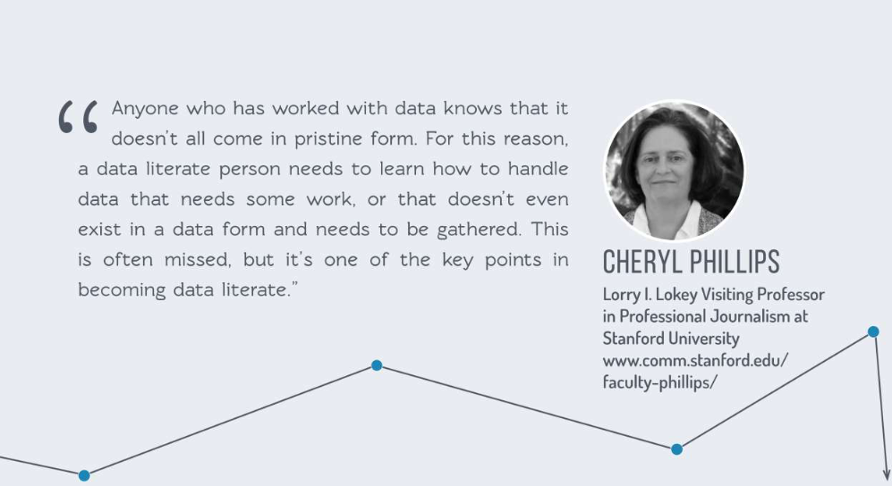

Slide 13
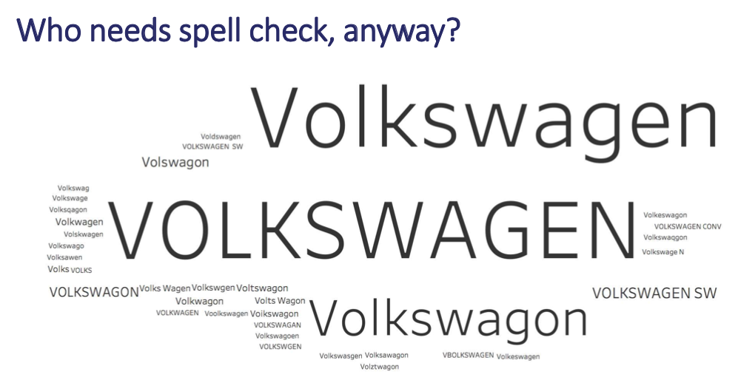

Slide 14
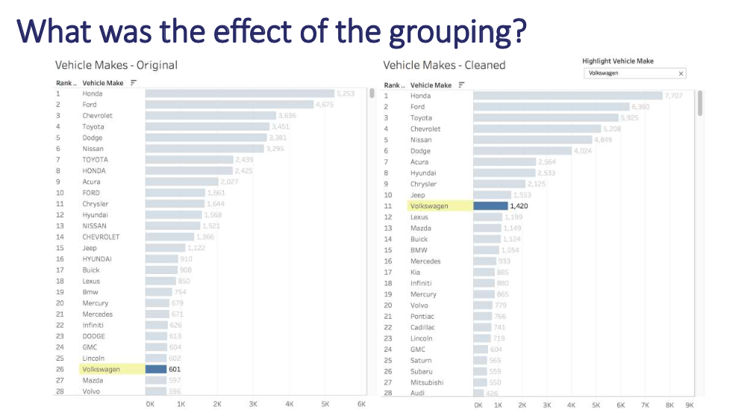

Slide 15
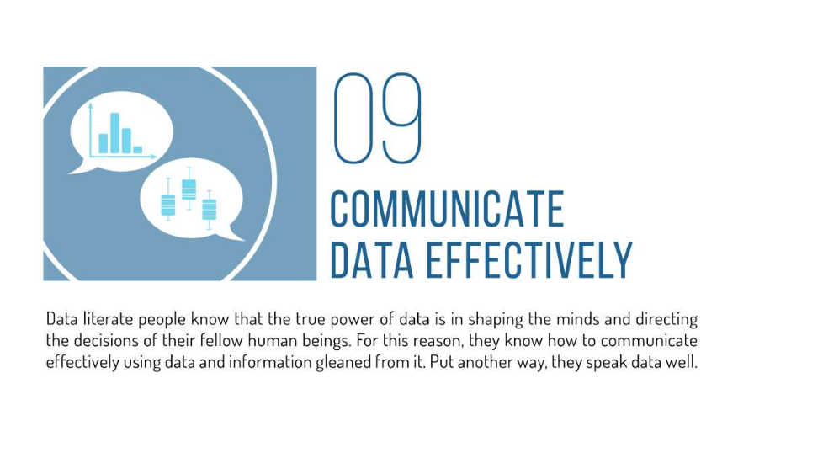

Slide 16
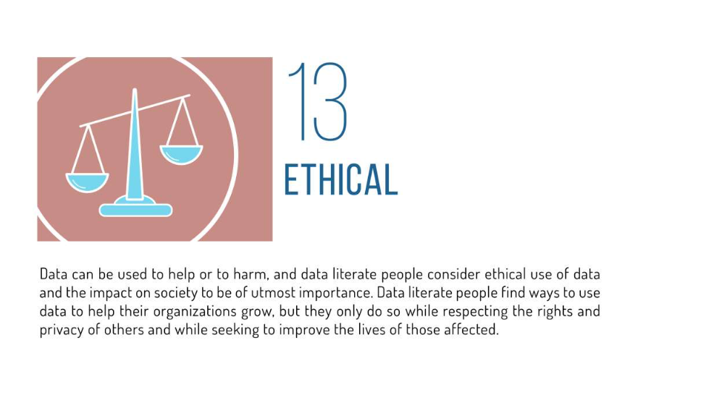

Slide 17
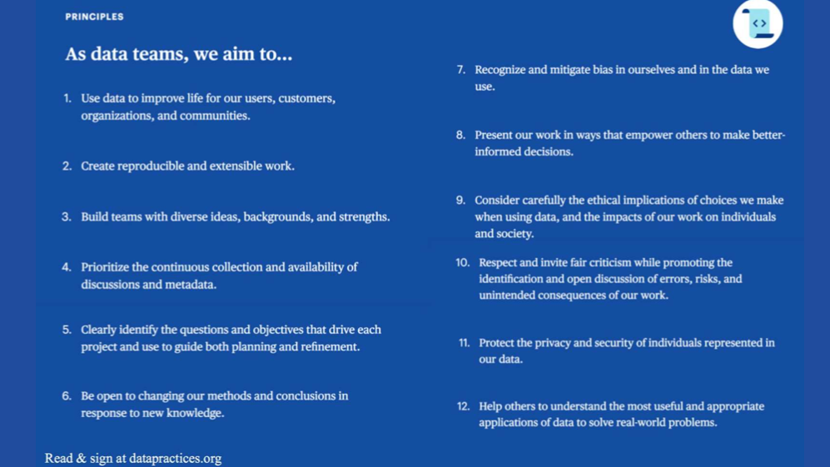

Slide 18
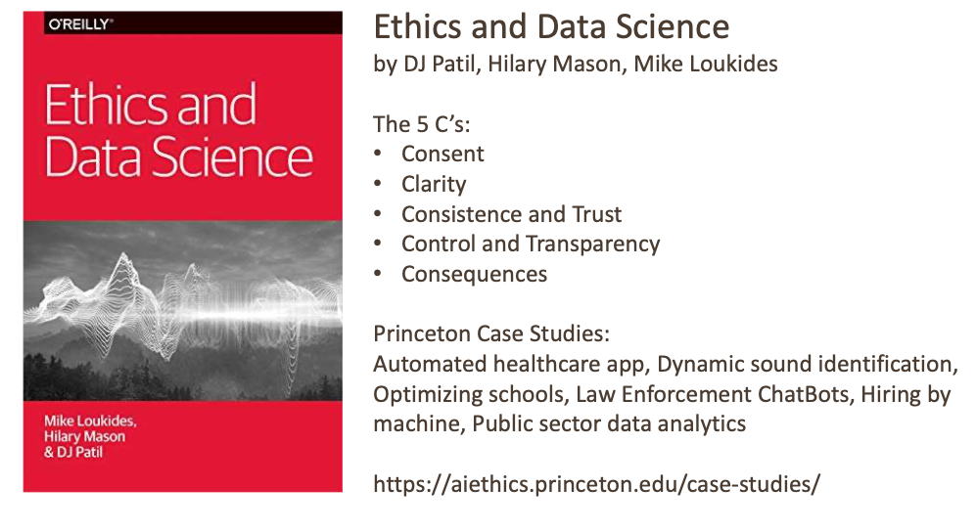

Slide 19
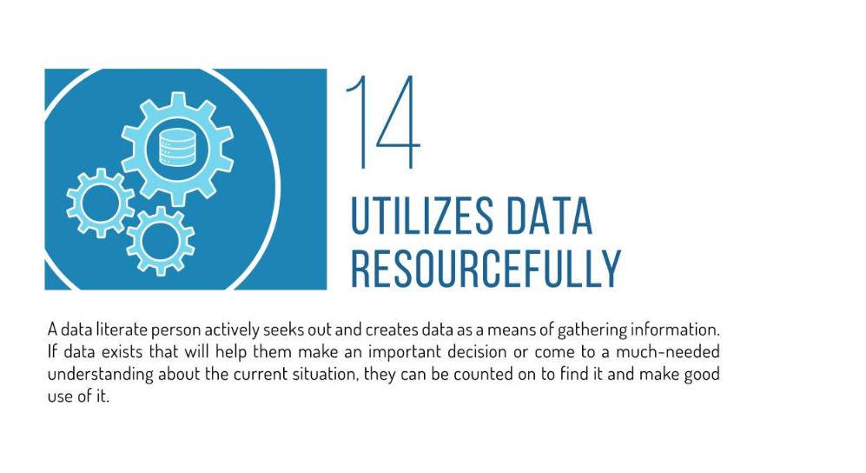

Slide 20
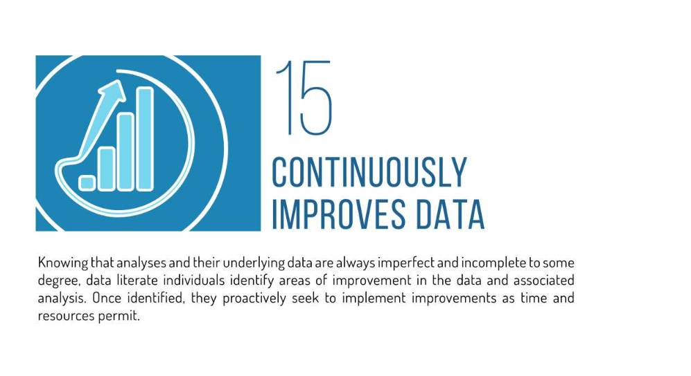

Slide 21
